Slide 1
Tabular: Probabilistic Inference from Excel
Claudio Russo (Microsoft Research)
Based on joint work with Andy Gordon (MSR, Edinburgh), Thore Graepel (MSR,UCL), Nicolas Rolland (MSR),
Johannes Borgström (Uppsala), Marcin Szymczak (Edinburgh)
Approx 2014, Edinburgh
Notes:
30 minute POPL talk, leave 5 minutes for questions
approx. 15 slides
ACM Principles of Programming Languages, January 2014

Slide 2
Model-Based Machine Learning
Given noisy data and a stochastic model of how that data was generated…
… condition the output of the model on the data …
… to learn the posterior distributions of parameters and latent variables in the model.
E.g. Bayesian Linear Regression
For some (X,Y) pairs, the model might be a noisy line, Y(X)= Gaussian(A*X+B,N) and we want to infer the uncertain slope A, intercept B, and noise N of the line as distributions.

Slide 4
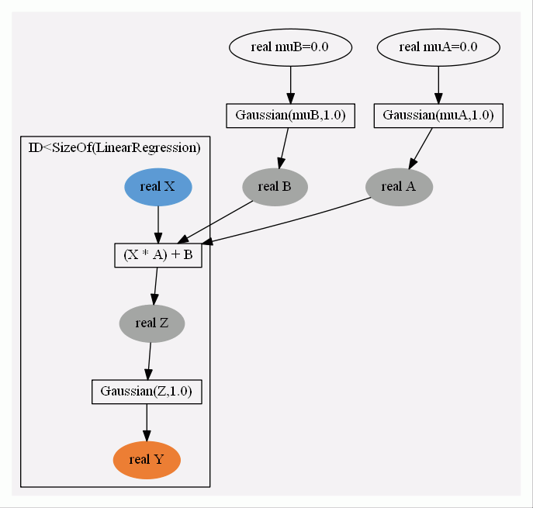
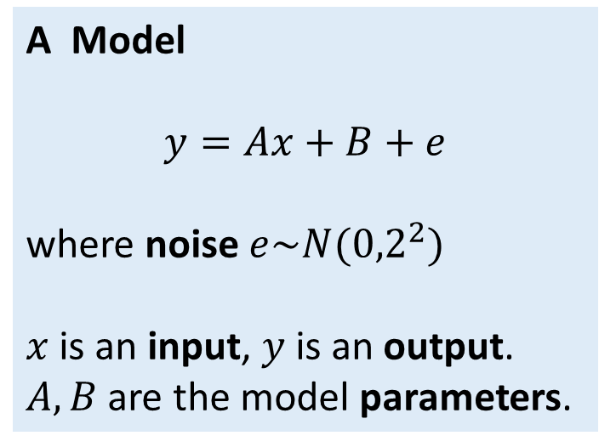
Linear Regression
A Model
$$y=Ax+B+e$$
where noise $e\sim N({0,2}^{2})$
$x$ is an input, $y$is an output.
$A,B$ are the model parameters.
XY
muA | real | hyper | 0
muB | real | hyper | 0
A | real | param | Gaussian(muA,1)
B | real | param | Gaussian(muB,1)
X | real | input
Z | real | latent | A*X + B
Y | real | output | Gaussian(Z,4)
Notes:
This example illustrates parameters, step 1

Slide 5
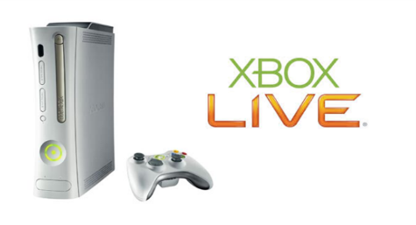

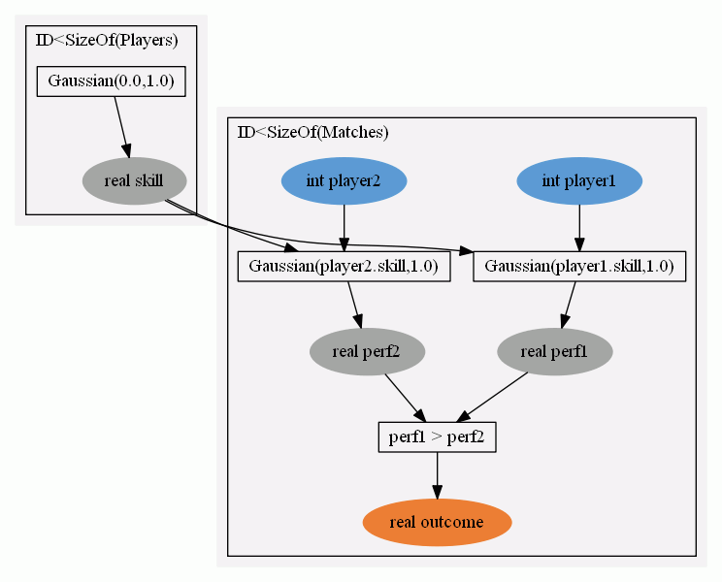
Graphical Models
Sample
Infer
Notes:
Trueskill
Bipartite graph: variables versus factors, plates
Three kinds of variables

Slide 6
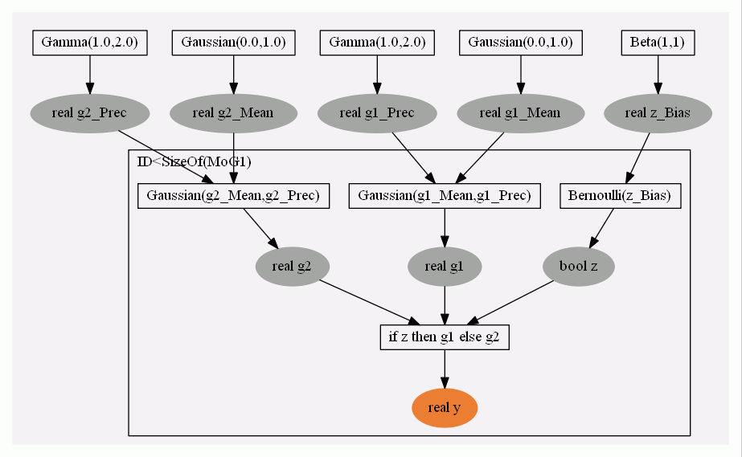
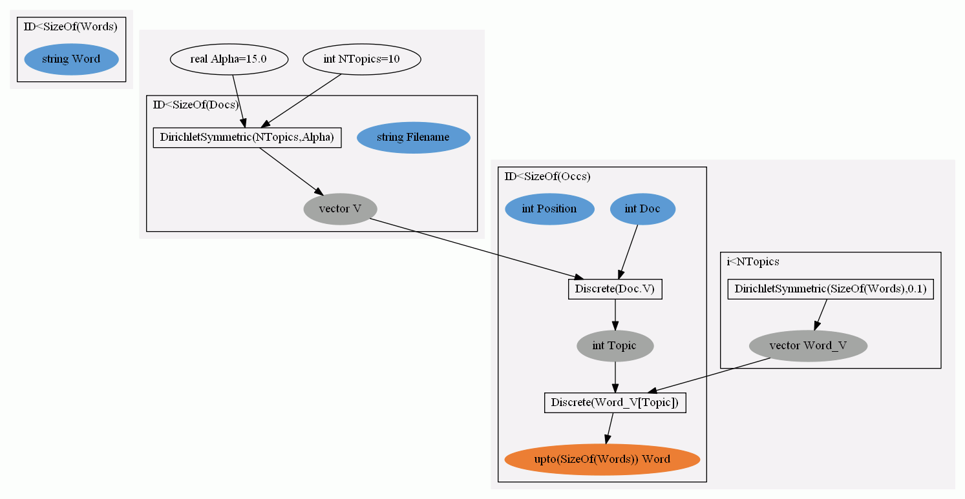
Graphical Models are Amazing!
A regression function inputs a tuple of variables,
and outputs one or more continuous variables.
A cluster analysis groups items so that items in each cluster are more like each other than to items in other clusters.
A topic model discovers the underlying topics so as to organise a set of documents.
And many other models and variations…
Notes:
One formalism, many models for many learning tasks.
But not easy to construct graphs directly.
Classifiers, recommenders, ranking systems, etc
A classifier inputs a vector of features and outputs a single value, the class.
A recommender predicts the rating or preference that a user would give to an item (such as music, books, or movies) based on previous ratings by a set of users.

Slide 7


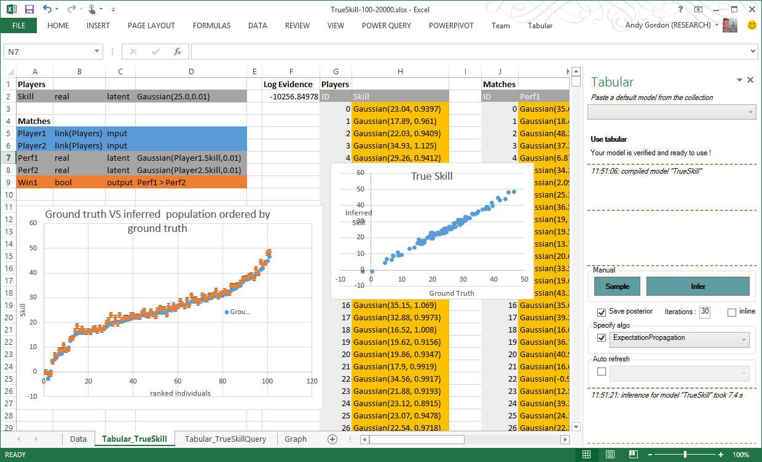
Tabular
Lets Excel users apply machine learning to relational data.
Users write models as (small) functional programs
Programs are probabilistic annotations on data schemas
Programs compile to factor graphs of Infer.NET
Infer.NET compiles graphs to efficient inference code
Tabular reports results of inference in spreadsheet.
Results are uncertain (distributions) and approximate.
Notes:
Probabilistic programming is a Hot Research topic, where machine learning algorithms are obtained by writing probabilistic models as programs.
A unique feature is that Tabular models are simply succinct annotations on the relational schema of the Excel data model.
We aim to expand the scope of MSRC’s Infer.NET system to embrace the large population of Excel users who’d like to model their data but are not programmers.
What are we trying to do?

Slide 8
Aims of Tabular
DSL to get insight from data with graphical models
Empower the well-populated end-user side of the spectrum:
  Data enthusiasts > ML devs > data scientists > ML PhDs
Tabular has three guiding principles:
  Language design based on annotations of the data schema
  Inference by querying latent variables and missing values
  Auto-suggest models based on the structure of the data
POPL’14 paper about 1 and 2, and shows how Tabular expresses InfernoDB, previous work on 3.
Notes:
Business users, with the questions, on a mission
Excellent analytical thinkers
Not DBAs, not programmers, not statisticians
hospital admin wanting to know why patients are re-admitted
car salesman wanting to know what cars worth buying at auction
Pat Hanrahan,
SIGMOD 2012

Slide 9
The Tabular Recipe
Start with the schema
Add latent columns
Write models for latent and output columns
Learn latent columns and table parameters, and/or
Predict missing values in output columns
We focus on this part of the cycle of learning from data, leaving gathering, preprocessing, visualizing to other tools (e.g. Excel)

Slide 10

TrueSkill
DATA:
Table of players in a two player game
Table of matches between pairs of players with some outcomes
PROBLEM(s):
Infer: player ranking by skill, given known match outcomes
Predict: probable values for unknown match outcomes
THE MODEL
Each player has a latent skill, a real drawn from a Gaussian.
For each match:
  a player’s performance is a noisy copy of her skill;
  player 1 wins if her performance exceeds player 2’s performance.

Slide 11
TrueSkill – Data
Players
Name | string
ID | Name
0 | Alice
1 | Bob
2 | Cynthia
Matches
Player1 | Link(Players)
Player2 | Link(Players)
Win1 | bool
ID | Player1 | Player2 | Win1
0 | 0 | 1 | False
1 | 1 | 2 | False
Notes:
Plates versus tables

Slide 12
TrueSkill
Players
Name | string | input
Skill | real | latent | Gaussian(25.0,0.01)
Matches
Player1 | link(Players) | input
Player2 | link(Players) | input
Perf1 | real | latent | Gaussian (Player1.Skill, 1.0)
Perf2 | real | latent | Gaussian (Player2.Skill, 1.0)
Win1 | bool | output | Perf1 > Perf2
Notes:
Our first Tabular program

Slide 13
Query-by-latent Column
ID | Name
0 | Alice
1 | Bob
2 | Cynthia
ID | Player1 | Player2 | Win1
0 | 0 | 1 | False
1 | 1 | 2 | False
ID | Skill
0 | Gaussian(22.5,1.45)
1 | Gaussian(25.22,1.53
2 | Gaussian(27.93,1.45)
ID | Perf1 | Perf2
0 | Gaussian(22.5,1.1) | Gaussian(25.2,1.1)
1 | Gaussian(25.2,1.1) | Gaussian(27.9,1.1)

Slide 14
Query-by-Missing-Value
ID | Name
0 | Alice
1 | Bob
2 | Cynthia
ID | Player1 | Player2 | Win1
0 | 0 | 1 | False
1 | 1 | 2 | False
2 | 2 | 0
ID | Player1 | Player2 | Win1
0 | 0 | 1 | False
1 | 1 | 2 | False
2 | 2 | 0 | Bernoulli(0.85)

Slide 15
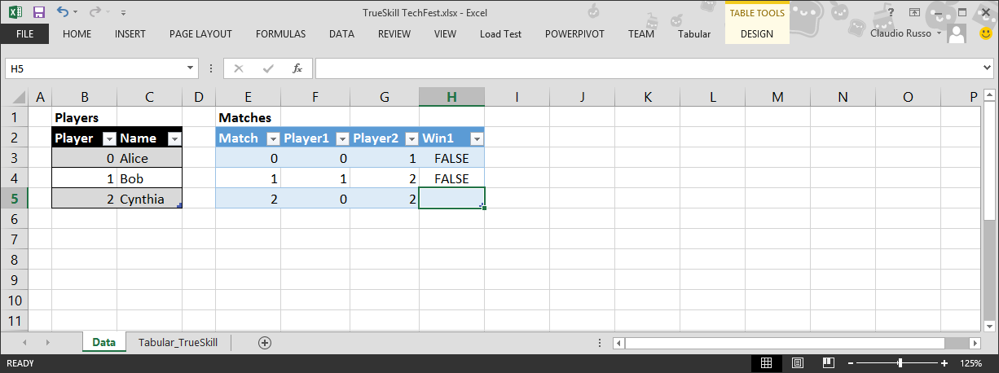
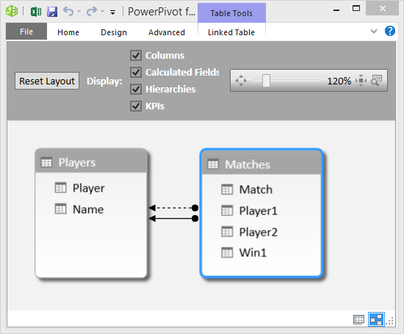
Data
(2) Add your tables and relationships to Excel’s data model
(1) Start with your data in Excel, and a question:
“Will Alice beat Cynthia?”
Notes:
The following mockup shows the Tabular experience in Excel on a deliberately tiny dataset.
There’s a five-step recipe for modelling with Tabular.
First, we get our data into Excel as tables. Here the data is inlined, but it could be imported from SQL or other external data sources.
In this case, we have tables of Players and Matches from some tournament.
The first row of the data says that Alice played Bob, and Alice lost.
The second row says that Bob played Cynthia, and Bob lost.
So Cynthia beat Bob, and Bob beat Alice.
The third row poses a question we want to answer: who is likely to win if Alice plays Cynthia?
Second, we add these tables to the relational data model that was introduced in Excel 2013.
Notice that when Excel displays schemas the attributes eg Player, Name are arranged vertically,
whereas in tables they are laid out horizontally.

Slide 16
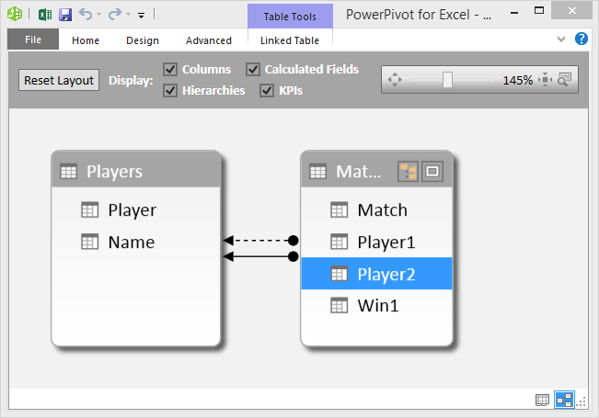
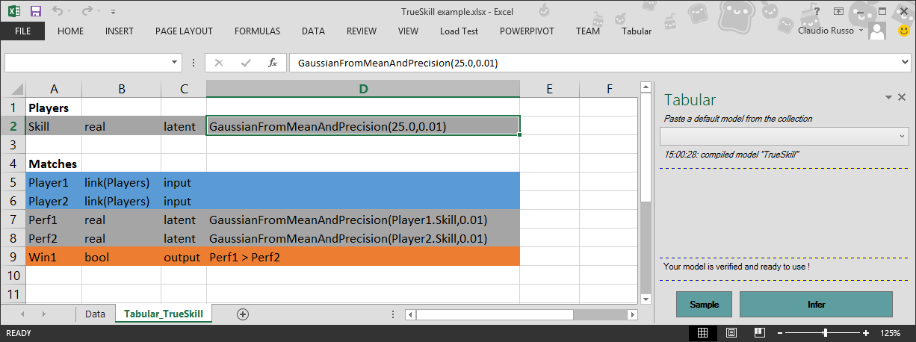
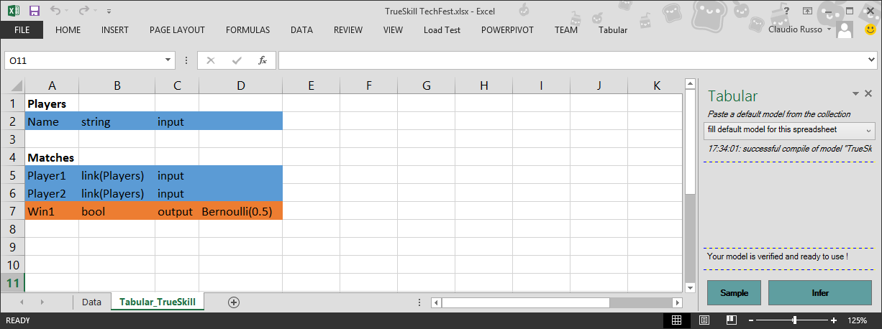
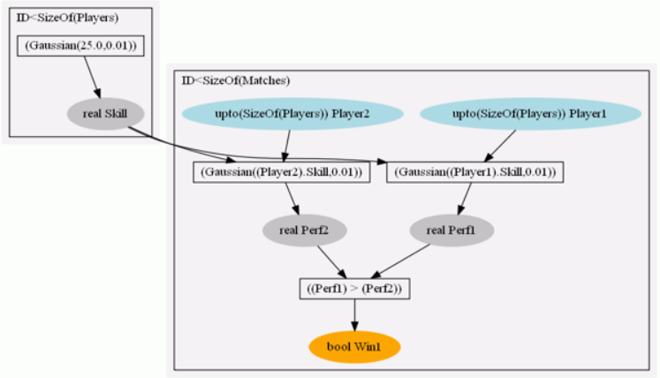
Model
(4) User adds “latent” attributes and probabilistic expressions to the model; removes irrelevant attributes
(3) Tabular provides a default model, derived from schema
Display as factor graph (for ML experts)
Notes:
Step (3) is that we write a probabilistic model of our data set, based on the schema.
In the schema, column B has the attributes of each table, while column C has their types.
For instance, Player1 and Player2 are “foreign keys”, ie, pointers, from the Matches table to the Players tables.
The attributes and types are a standard part of the Data Model.
The new part is that we annotate each attribute with whether it is an input, an output, or a hidden or “latent” variables. Blue is for input, orange is for output, and grey is for latent.
The idea is that each table defines a “storyline” of how the output and latent attributes are generated from the inputs.
For instance, the Players table says that each row has a Skill variable drawn from Gaussian(25,0.01), ie, a normal distribution with mean 25 and precision 0.01.
The Matches tables says that each row takes the foreign keys Player1 and Player2 as input, generates the performances Perf1 and Perf2 by adding a little noise to the skills of the players, and makes Win1=TRUE if Perf1 > Perf2.

Slide 17
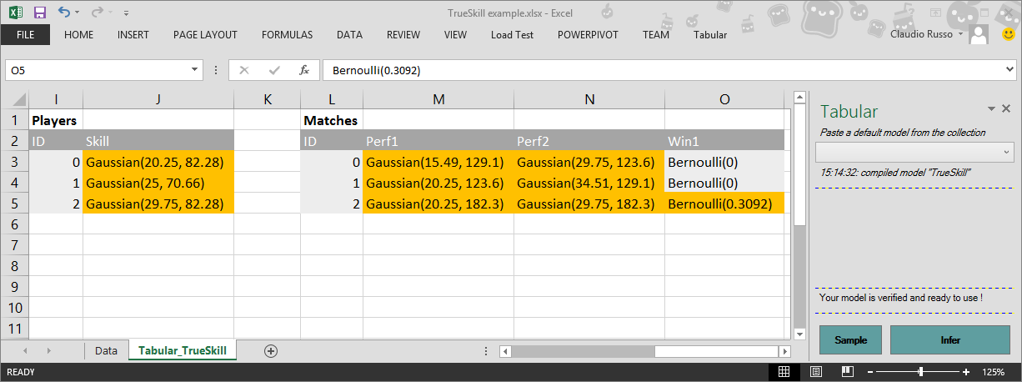
Inference
(5) Tabular compiles to Infer.NET, hence infers latent columns and missing values
“Alice has 30% chance of beating Cynthia”
(6) If poor fit, return to model sheet, adjust, repeat.
“Alice < Bob < Cynthia”
Notes:
Tabular compiles to Infer.NET, and this Predictions tab shows the outcomes of inference.
It shows our two tables, including the original input and output data, but also with distributions in the latent columns. For instance, the Skill column has been filled in with distributions showing that Cynthia has a skill with mean 29.75, while Alice has only skill 20.25.
Tabular also fills in any values missing from output columns. For instance, the Win1 column for Alice and Cynthia is filled in with 30%, meaning that given that Cynthia beat Bob and Bob beat Alice, there’s an 30% chance that Cynthia will beat Alice.
Tabular builds on the Inferno principle of expressing queries as missing values in spreadsheets; it adds the idea of an explicit representation of the model. It is hard to get models right first-time for datasets, but Tabular allows for rapid prototyping of models by directly editing the model, all within Excel.

Slide 18
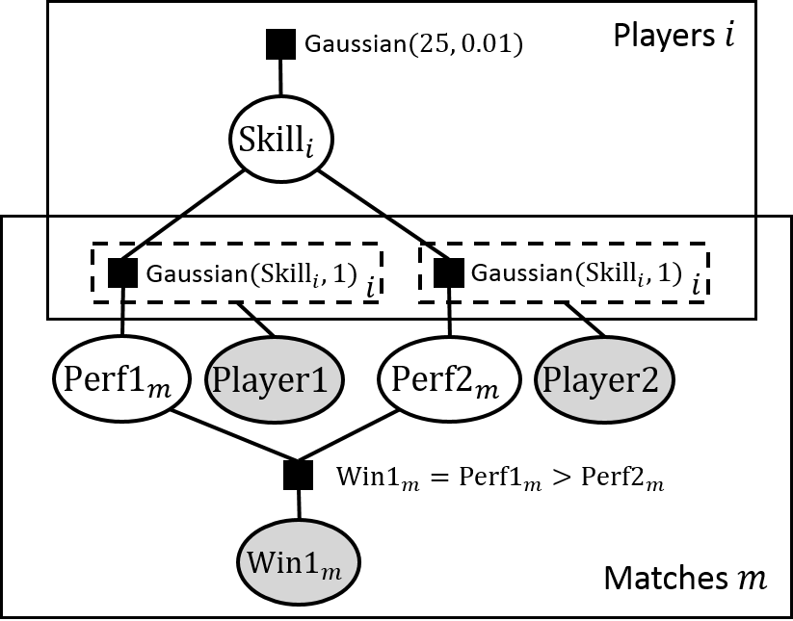
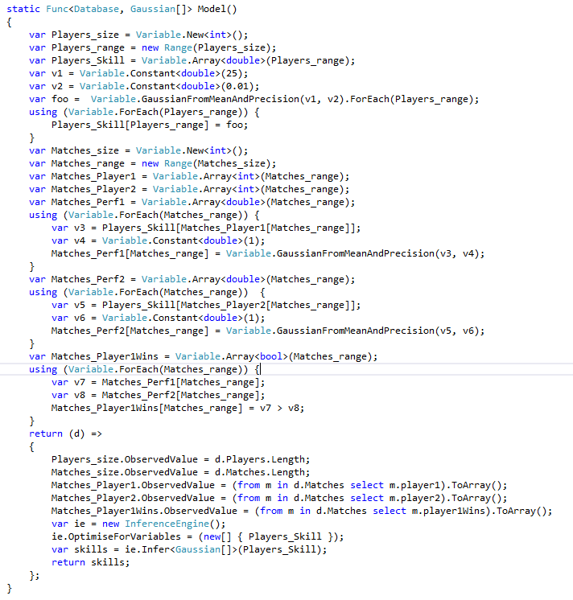
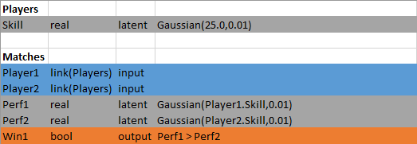
Tabular vs. Infer.NET

Slide 19
Linear Regression in Tabular
XY
muA | real | hyper | 0
muB | real | hyper | 0
A | real | param | Gaussian(muA,1)
B | real | param | Gaussian(muB,1)
X | real | input
Z | real | latent | A*X + B
Y | real | output | Gaussian(Z,1)
Notes:
This example illustrates parameters, step 1

Slide 20
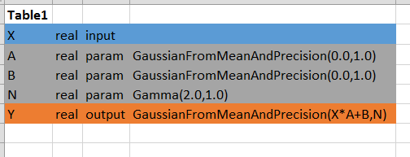
Linear Regression in Tabular
Notes:
This example illustrates parameters, step 1

Slide 21
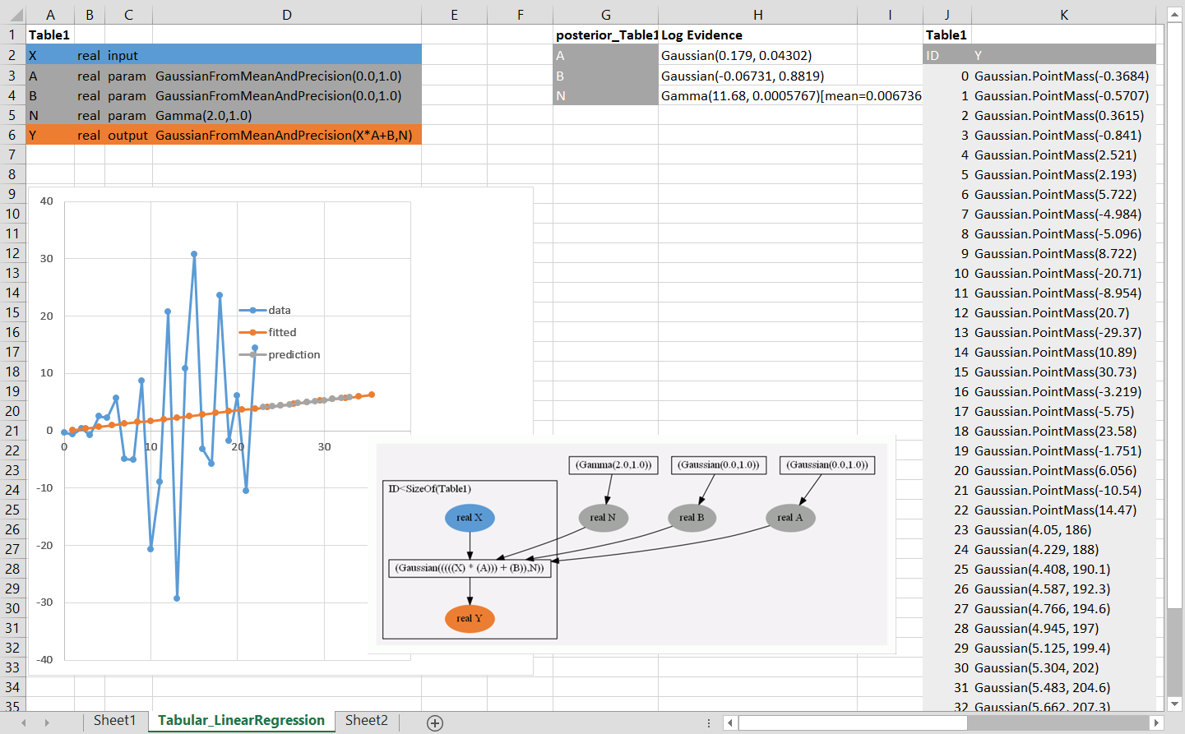
Linear Regression in Tabular
Notes:
This example illustrates parameters, step 1

Slide 22
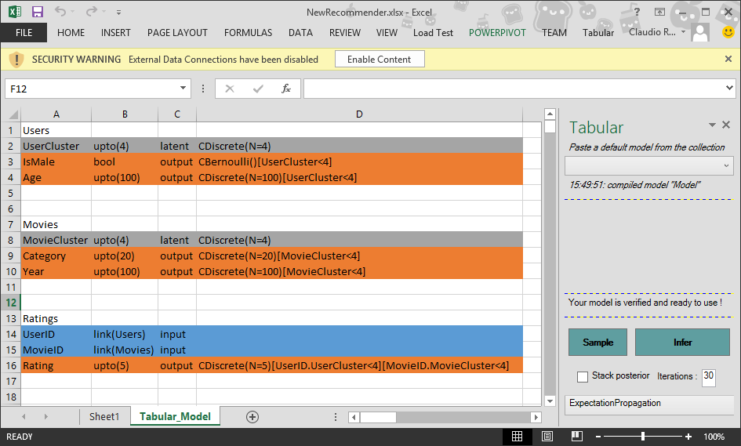
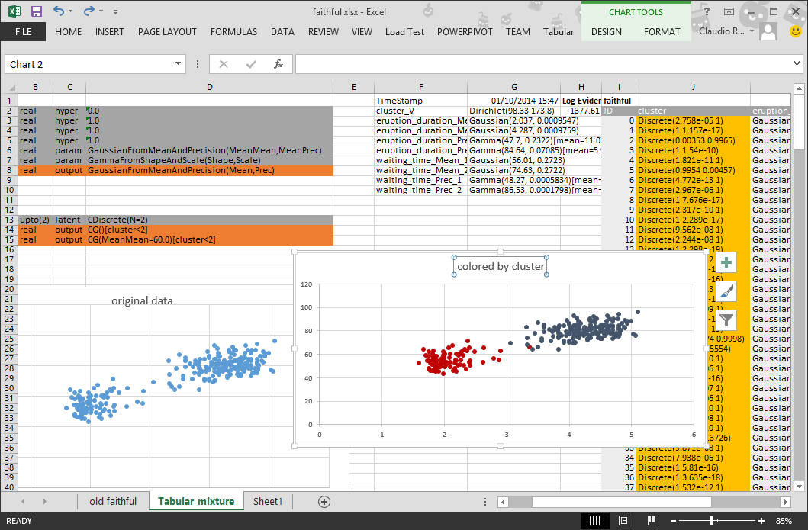
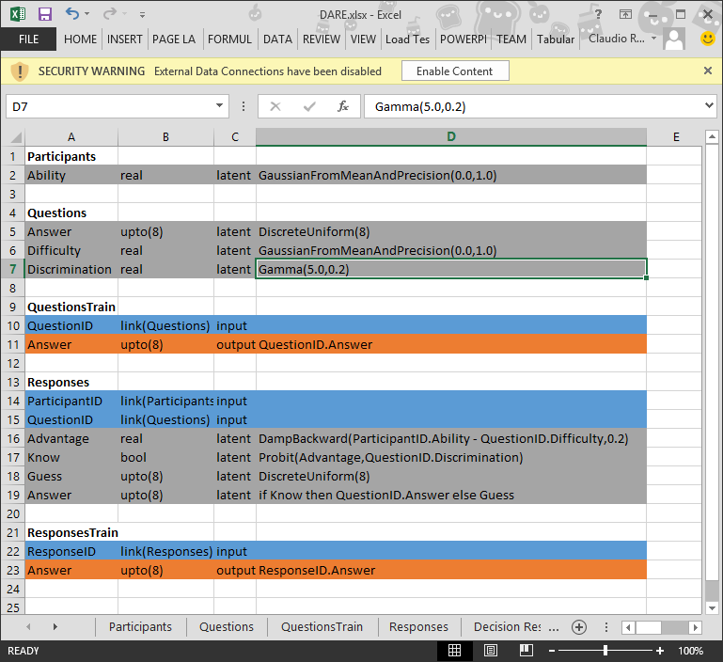
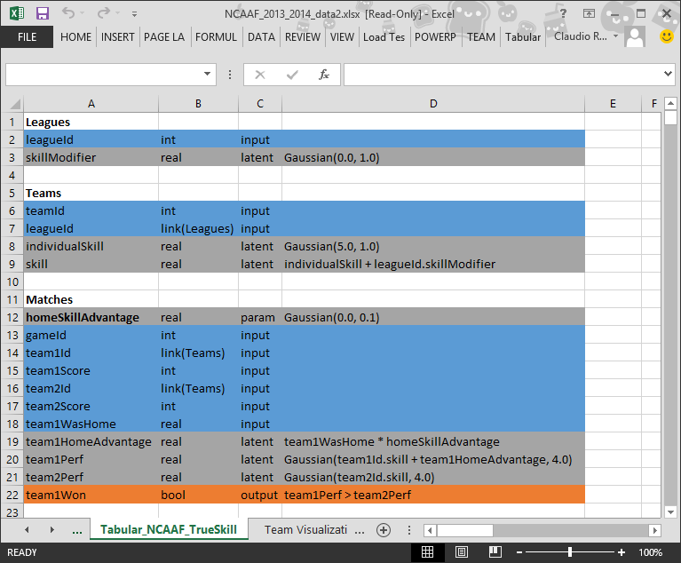
Other Tabular models …
Recommender
Clustering
NCAA
DARE

Slide 23
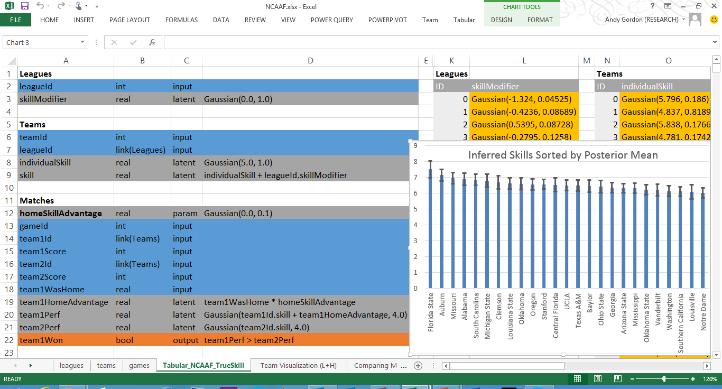
Tabular as a Spreadsheet DSL
Notes:
Our first internal customers

Slide 24
Case study: Psychometrics
public static void CreateAndRunDAREModel(
Gaussian abilityPrior, Gaussian difficultyPrior, Gamma discriminationPrior,
int nParticipants, int nQuestions, int nChoices,
int[] participantOfResponse, int[] questionOfResponse,
int[] response, int[] trainingResponseIndices,
int[] answer, int[] trainingQuestionIndices)
{ // Model
var Evidence = Variable.Bernoulli(0.5).Named("evidence");
var EvidenceBlock = Variable.If(Evidence);
var NQuestions = Variable.New<int>().Named("nQuestions");
var NParticipants = Variable.New<int>().Named("nParticipants");
var NChoices = Variable.New<int>().Named("nChoices");
var NResponses = Variable.New<int>().Named("nResponses");
var NTrainingResponses = Variable.New<int>().Named("nTrainingResponses");
var NTrainingQuestions = Variable.New<int>().Named("nTrainingQuestions");
var p = new Range(NParticipants).Named("p");
var q = new Range(NQuestions).Named("q");
var c = new Range(NChoices).Named("c");
var n = new Range(NResponses).Named("n");
var tr = new Range(NTrainingResponses).Named("tr");
var tq = new Range(NTrainingQuestions).Named("tq");
var AnswerOfQuestion = Variable.Array<int>(q).Named("answer");
AnswerOfQuestion[q] = Variable.DiscreteUniform(c).ForEach(q);
var QuestionOfResponse = Variable.Array<int>(n).Named("questionOfResponse");
var ParticipantOfResponse = Variable.Array<int>(n).Named("participantOfResponse");
var AnswerOfResponse = Variable.Array<int>(n).Named("response");
QuestionOfResponse.SetValueRange(q);
ParticipantOfResponse.SetValueRange(p);
AnswerOfResponse.SetValueRange(c);
var Know = Variable.Array<bool>(n).Named("know");
var Ability = Variable.Array<double>(p).Named("ability");
Ability[p] = Variable.Random(abilityPrior).ForEach(p);
var Difficulty = Variable.Array<double>(q).Named("difficulty");
Difficulty[q] = Variable.Random(difficultyPrior).ForEach(q);
var Discrimination = Variable.Array<double>(q).Named("discrimination");
Discrimination[q] = Variable.Random(discriminationPrior).ForEach(q);
using (Variable.ForEach(n))
{
var advantage = (Ability[ParticipantOfResponse[n]] -
Difficulty[QuestionOfResponse[n]]).Named("advantage");
var advantageDamped = Variable<double>.Factor<double, double>(
Damp.Backward, advantage,0.2).Named("advantageDamped");
var advantageNoisy = Variable.GaussianFromMeanAndPrecision(advantageDamped,
Discrimination[QuestionOfResponse[n]]).Named("advantageNoisy");
Know[n] = (advantageNoisy > 0);
using (Variable.If(Know[n]))
AnswerOfResponse[n] = AnswerOfQuestion[QuestionOfResponse[n]];
using (Variable.IfNot(Know[n]))
AnswerOfResponse[n] = Variable.DiscreteUniform(c);
}
var TrainingResponseIndices = Variable.Array<int>(tr).Named("trainingResponseIndices");
TrainingResponseIndices.SetValueRange(n);
var ObservedResponseAnswer = Variable.Array<int>(tr).Named("observedResponseAnswer");
ObservedResponseAnswer[tr] = AnswerOfResponse[TrainingResponseIndices[tr]];
var TrainingQuestionIndices = Variable.Array<int>(tq).Named("trainingQuestionIndices");
TrainingQuestionIndices.SetValueRange(q);
var ObservedQuestionAnswer = Variable.Array<int>(tq).Named("observedQuestionAnswer");
ObservedQuestionAnswer[tq] = AnswerOfQuestion[TrainingQuestionIndices[tq]];
EvidenceBlock.CloseBlock();
// Hook up the data and run inference
var nResponse = response.Length;
NQuestions.ObservedValue = nQuestions;
NParticipants.ObservedValue = nParticipants;
NChoices.ObservedValue = nChoices;
NResponses.ObservedValue = nResponse;
var nTrainingResponses = trainingResponseIndices.Length;
NTrainingResponses.ObservedValue = nTrainingResponses;
var nTrainingQuestions = trainingQuestionIndices.Length;
NTrainingQuestions.ObservedValue = nTrainingQuestions;
ParticipantOfResponse.ObservedValue = participantOfResponse;
QuestionOfResponse.ObservedValue = questionOfResponse;
TrainingResponseIndices.ObservedValue = trainingResponseIndices;
ObservedResponseAnswer.ObservedValue = Util.ArrayInit(nTrainingResponses, i =>
response[trainingResponseIndices[i]]);
TrainingQuestionIndices.ObservedValue = trainingQuestionIndices;
ObservedQuestionAnswer.ObservedValue = Util.ArrayInit(nTrainingQuestions, i =>
answer[trainingQuestionIndices[i]]);
var Engine = new InferenceEngine()
{ ShowTimings = true,ShowWarnings = false,ShowProgress = false,NumberOfIterations = 10 };
var AnswerOfResponsePosterior = Engine.Infer<Discrete[]>(AnswerOfResponse);
var AnswerOfQuestionPosterior = Engine.Infer<Discrete[]>(AnswerOfQuestion);
var LogEvidence = Engine.Infer<Bernoulli>(Evidence).LogOdds;
var AbilityPosterior = Engine.Infer<Gaussian[]>(Ability);
var DifficultyPosterior = Engine.Infer<Gaussian[]>(Difficulty);
var DiscriminationPosterior = Engine.Infer<Gamma[]>(Discrimination);
}
Participants
Ability | real | latent | Gaussian(0.0,1.0)
Model | Lang. | LOC Data | LOC Model | LOC Inference | LOC Total | Compile (s) | Infer (s) | Model log evidence | Avg. log prob. test Responses | Avg. log prob. test answers
A | Tabular II | 0 | 17 | 0 | 17 | 0.39 | 0.40 | -7499.74 | -1.432 | -3.424
A | Infer.NET | 73 | 45 | 20 | 138 | 0.32 | 0.38 | -7499.74 | -1.432 | -3.425
DA | Tabular II | 0 | 18 | 0 | 18 | 0.39 | 0.46 | -5933.52 | -1.118 | -0.739
DA | Infer.NET | 73 | 47 | 21 | 141 | 0.34 | 0.43 | -5933.25 | -1.118 | -0.724
DARE | Tabular II | 0 | 19 | 0 | 19 | 0.40 | 2.86 | -5820.40 | -1.119 | -0.528
DARE | Infer.NET | 73 | 49 | 22 | 144 | 0.37 | 2.8 | -5820.40 | -1.119 | -0.528
Questions
Answer | int | output | DiscreteUniform(8)
Difficulty | real | latent | Gaussian(0.0,1.0)
Discrimination | real | latent | Gamma(5.0,0.2)
Responses
PariticipantID | Link(Participants) | input
QuestionID | Link(Questions) | input
Advantage | real | latent | DB(ParticipantID.Ability- QuestionID.Difficulty,0.2)
Know | bool | latent | Probit(Advantage,QuestionID.Discrimination)
Guess | int | latent | DiscreteUniform(8)
Response | int | output | if Know then QuestionID.Answer else Guess
Replicated Infer.NET C# by Bachrach et al 2012
Same statistical results, much less code, slight loss in perf
Notes:
Models first published in (Bachrach et. al 2012)
Data drawn from multiple choice intelligence test
60 questions with 8 possible answers (one correct)
121 participants
Five linked tables: Participants, Questions and Responses (linking the two), plus QuestionsTrain and ResponsesTrain indicating subsets of correct and provided answers for training.
Each participant is characterised by their latent Ability (Gaussian).
Each question is characterized by its latent true Answer (discrete) and (in fuller model) its Difficulty (Gaussian) and Discrimination (Gamma).
Responses relate ParticipantID and QuestionID to Participant’s answers.
Models A, DA, and DARE successively model the ability of the student, adding Question Difficulty and Discrimination variables for improved accuracy.

Slide 25
Semantics of Schemas
Players
Name | string | input
Skill | real | latent | Gaussian(25.0,0.01)
For each row r of Players,
Skill ~ Gaussian(25.0,0.01)
Matches
Player1 | link(Players) | input
Player2 | link(Players) | input
Perf1 | real | latent | Gaussian (Player1.Skill, 1.0)
Perf2 | real | latent | Gaussian (Player2.Skill, 1.0)
Win1 | bool | output | Perf1 > Perf2
For each row r of Matches,
Player1 := r.Player1
Player2 := r.Player2
Perf1 ~ Gaussian(Players[Player1].Skill, 1.0)
Perf2 ~ Gaussian(Players[Player2].Skill, 1.0)
Win1 := (Perf1 > Perf2)
if (r.Win1 not null)
observe (Win1 == r.Win1)
Notes:
Explain semantics of Tabular by 2-step translation to probabilistic programs with factor graph semantics

Slide 26
Functions
Graphical models are first-order – there’s no abstraction
Tabular adds functions; define once; use several times
Functions are defined as table fragments.
A function call expands one column to several columns
function:MyGaussian
MeanOfMean | real | hyper | 0.0
PrecOfMean | real | hyper | 1.0
Mean | real | param | GaussianFromMeanAndPrecision(MeanOfMean,PrecOfMean)
Prec | real | param | GammaFromShapeAndScale(1.0,1.0)
MyGaussian | real | output | GaussianFromMeanAndPrecision(Mean,Prec)
faithful
eruption_duration | real | output | MyGaussian()
waiting_time | real | output | MyGaussian(MeanOfMean=60.0)
faithful
Mean | real | param | GaussianFromMeanAndPrecision(0.0,1.0)
Prec | real | param | GammaFromShapeAndScale(1.0,1.0)
eruption_duration | real | output | GaussianFromMeanAndPrecision(Mean,Prec)
waiting_time | real | output | MyGaussian(MeanOfMean=60.0)
Notes:
each point x=duration y=waiting time, in minutes for each eruption of a geyser
explain Tabular line-by-line
detailed semantics in paper
easier to comprehend graphically

Slide 27
Indexed Models
An indexed model M[E_{index}< E_{size}] is a model with an array of E_{size} copies of the parameter of M; the parameter to produce each output is selected by E_{index}.
faithful
cluster | upto(2) | latent | CDiscrete(N=2)
eruption_duration | real | output | MyGaussian()[cluster < 2]
waiting_time | real | output | MyGaussian(MeanOfMean=60.0)[cluster < 2]
faithful
cluster | upto(2) | latent | CDiscrete(N=2)
Mean | real[2] | param | [for i < 2 -> GaussianFromMeanAndPrecision(0.0,1.0)]
Prec | real[2] | param | [for i < 2 -> GammaFromShapeAndScale(1.0,1.0)]
eruption_duration | real | output | GaussianFromMeanAndPrecision(Mean.[cluster],Prec.[cluster])
waiting_time | real | output | MyGaussian(MeanOfMean=60.0)[cluster < 2]
Notes:
each point x=duration y=waiting time, in minutes for each eruption of a geyser
explain Tabular line-by-line
detailed semantics in paper
easier to comprehend graphically

Slide 28
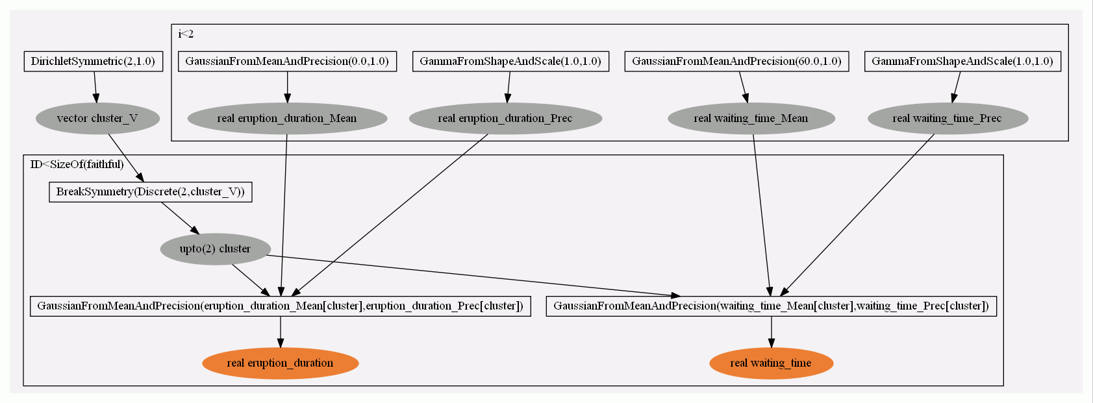
Tabular vs Graphical Models
faithful
cluster | upto(2) | latent | CDiscrete(N=2)
eruption_duration | real | output | MyGaussian()[cluster]
waiting_time | real | output | MyGaussian(MeanOfMean=60.0)[cluster]

Slide 29
Automatic Model Suggestion
InfernoDB – Sameer Singh, Thore Graepel (2012)
Automatically get recommender from relational schema
(PL) Problem: visual notation becoming unwieldy
Notes:
Finally, we turn to automatic model suggestion.
Graphical model induced from relational structure.
In this example, the schema for a user/movie/ratings database induced a recommender.
But team lacked any sort of compositional notation for the induced models.
Tabular solves their problem, and now we’re working with them.
For each pairs of user/movie cluster, separate distribution over ratings.
Predict Age, Gender, Occupation given the ratings
Predict Movie genres given user details
Predict ratings for a new movie given its genres

Slide 30
Automatic Model Suggestion
InfernoDB – Sameer Singh, Thore Graepel (2012)
Users
UserCluster | int | latent | CDiscrete(N=4)
Gender | bool | output | CBernoulli()[UserCluster]
Age | int | output | CDiscrete(N=4)[UserCluster]
Movies
MovieCluster | int | latent | CDiscrete(N=4)
Genre | int | output | CDiscrete(N=20)[MovieCluster]
Year | int | output | CDiscrete(N=100)[MovieCluster]
Ratings
UserID | link(Users) | input
MovieID | link(Movies) | input
Score | int | output | CDiscrete(N=5) [UserID.UserCluster] [MovieID.MovieCluster]
Model expressions allow us to recast early work on model suggestion as probabilistic metaprogramming
Notes:
Finally, we turn to automatic model suggestion.
Graphical model induced from relational structure.
In this example, the schema for a user/movie/ratings database induced a recommender.
But team lacked any sort of compositional notation for the induced models.
Tabular solves their problem, and now we’re working with them.
For each pairs of user/movie cluster, separate distribution over ratings.
Predict Age, Gender, Occupation given the ratings
Predict Movie genres given user details
Predict ratings for a new movie given its genres

Slide 31
Tabular Summary
A DSL and Excel plug-in for model based ML.
Aimed a non-expert data enthusiasts.
Programs are probabilistic annotations on existing schemas.
More concise, scalable notation than factor graphs.
Higher level of abstraction (tables, functions, indexing, dependent types)
Work in progress: automatic suggestion of models from schemas.
Download: http://research.microsoft.com/tabular
See me for a demo!
http://research.microsoft.com/infernet

Slide 32
Tabular Contributions
Programs are probabilistic annotations on existing schemas.
Columns marked as hyper, param, input, output, or latent so as to define factor graphs with plates and parameters.
Query-by-latent-column and query-by-missing-value.
A grammar of model expressions to assemble complex hierarchical factor graphs:
Work in progress: functions and dependent types, time series, automatic suggestion of models from schemas
M ::= E | P(h₁=E₁,…,h_{n}=E_{n}) | M[E_{index}<E_{size}]
http://research.microsoft.com/fun

Slide 33
Questions?

Slide 34
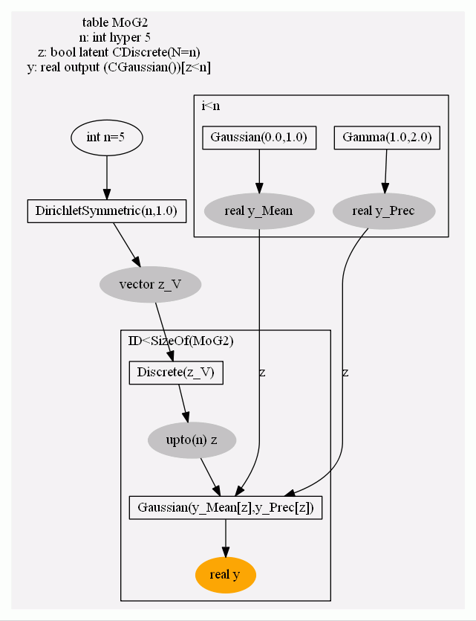
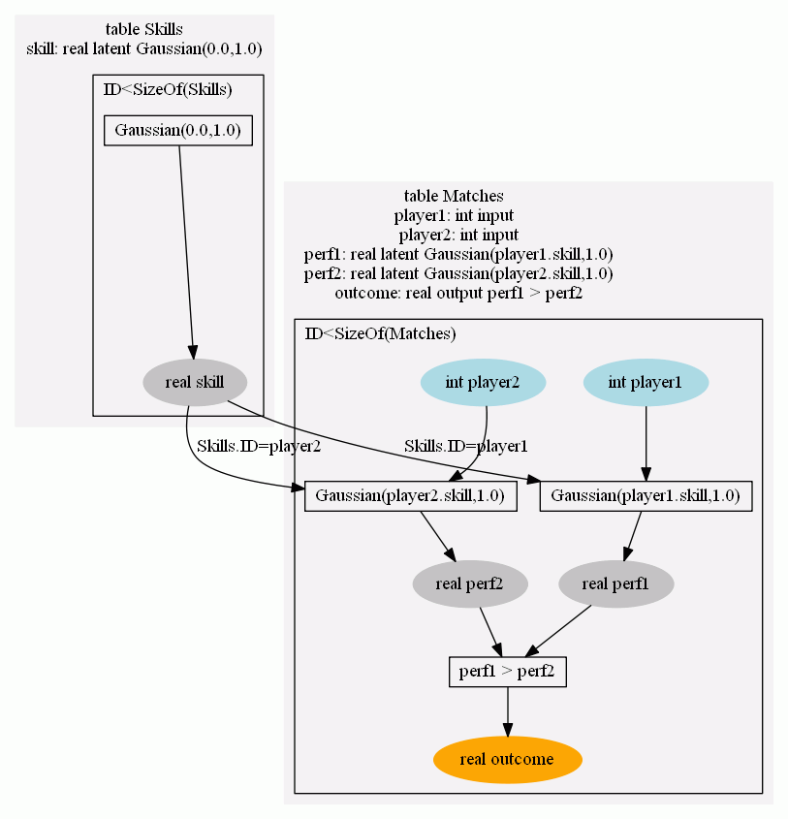
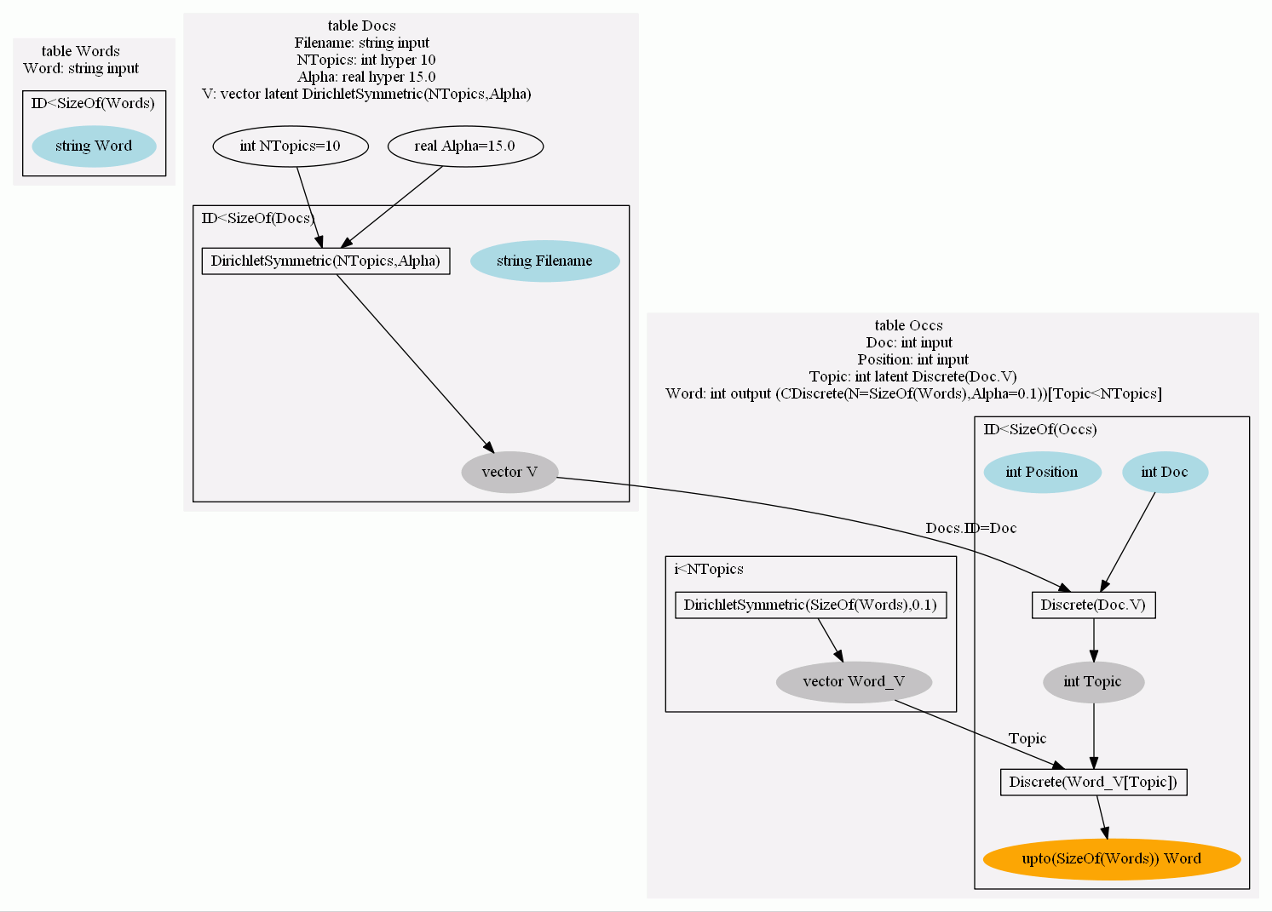
Tabular programs denote factor graphs
Clustering (Mixture of Gaussians)
Performance Ranking (TrueSkill)
Topic Model (LDA)
Notes:
Factor graphs define joint distribution over a set of random variables, and also are basis for efficient and scalable inference by message-passing.
Tabular is a very compact notation for factor graphs, and uniquely is based on relational structure.

Slide 35
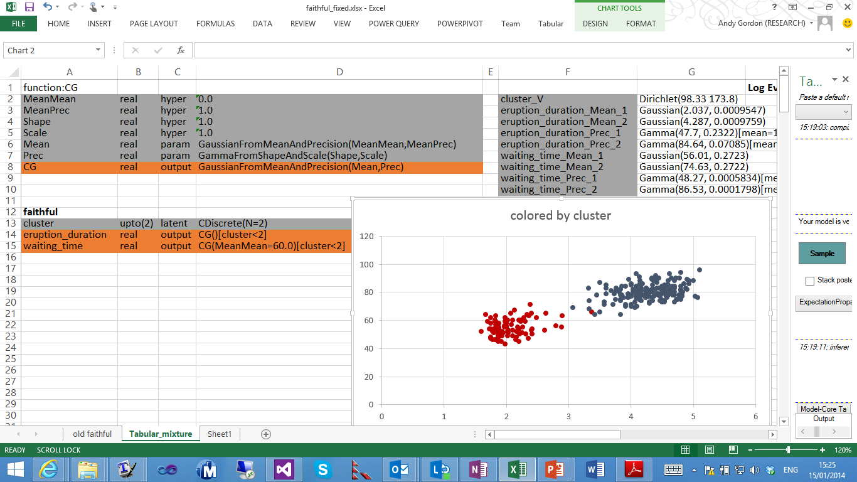
Mixture of Gaussians
MoG
Z | bool | latent | CBernoulli(alpha=2)
G1 | real | latent | CGaussian()
G2 | real | latent | CGaussian()
Y | bool | output | if Z then G1 else G2
Z$ ~ Beta(2,1)
G1$.Mean ~ Gaussian(1,0)
G1$.Prec ~ Gamma(1,1)
G2$.Mean ~ Gaussian(1,0)
G2$.Prec ~ Gamma(1,1)
For each row r of MoG,
Z ~ Bernoulli(Z$)
G1 ~ Gaussian(G1$.Mean,G1$.Prec)
G2 ~ Gaussian(G2$.Mean,G2$.Prec)
Y := if Z then G1 else G2
if (r.Y not null) observe (Y == r.Y)
Notes:
Plates versus tables

Slide 36
(3) Data enthusiasts need help
Pat Hanrahan, SIGMOD 2012, http://www.graphics.stanford.edu/~hanrahan/talks/enthusiasts.pdf
Notes:
Pat Hanrahan,
SIGMOD 2012
Business users, with the questions, on a mission
Excellent analytical thinkers
Not DBAs, not programmers, not statisticians

Slide 37
(1) Graphical Models
Sample
Infer

