Slide 1
Trading Functionality for Power within Applications
Melanie Kambadur and Martha A. Kim
{melanie | martha}@cs.columbia.edu
Columbia University, New York, NY
APPROX @ PLDI 2014
Notes:
Thanks for the introduction…
I’m going to talk today about some energy efficiency research I’ve been working on with my advisor, Martha Kim. We’ve been thinking about very large-grain approximation, where we trade functionality at the source code level for power savings. I’ll show you what I mean with a simple example…

Slide 2
Running on a power constrained system; app should consume <=80W at a time.
Mobile Phone Application

Slide 3
Mobile Phone Application

Slide 4
Too much power!
Mobile Phone Application

Slide 5
Power ok now.
Could handle with HW DVFS (Dynamic Voltage and Frequency Scaling), but you get a slowdown
25% Increase

Slide 6
Smart DVFS (with OS/ Compiler/ language help) might decrease slowdown
10% Increase
Notes:
Note that this is “state of the art”

Slide 7
Smart DVFS (with OS/ Compiler/ language help) might decrease slowdown
Majority of existing techniques trade power for runtime (and only save energy when there’s no work to do)
10% Increase
Notes:
Note that this is “state of the art”

Slide 8
Why not trade functionality instead of time?
Mobile Phone Application
Third Party
Advertisement

Slide 9
Why not trade functionality instead of time?
Temporarily kill ad, and save energy as well as power!
0% Increase

Slide 10
Use dynamic feedback to decide if and when to make functionality tradeoffs.
Mobile Phone App
Profile power
Start ad
if (too much
power), then:
Kill ad
else, resume…

Slide 11
Specifically, use Energy Exchanges
Mobile Phone App
audit {
…
…
} record(usage_t *u)
Start ad
if (u->power >= 80):
Kill ad
else continue

Slide 12
Challenges to address
Accuracy / Precision
Efficiency of the profiling itself
Interoperability with existing power tools
Programmability / Usability
Notes:
“You might ask why we even need Energy exchanges when energy profiling already exists…”

Slide 13
Challenges to address
Could handle w/ HW, but need to deal with new limitations:
- too few counters
- counter overflow
- security
Accuracy / Precision
Efficiency
Interoperability power saving tools
Programmability

Slide 14
Energy Exchanges made possible by C++ Library: NRGX.h
Built on Intel RAPL counters
Primitives to wrap code in power, energy, and runtime called “audits”
Efficiently handles multiple audits
Attempts to overcome HW limitations

Slide 15
Example: bodytrack
for (int i=0; i < frames; i=i+1) {
// DO FRAME PROCESSING
}
Goal: keep program’s entire execution within a predetermined energy budget

Slide 16
Example: bodytrack
for (int i=0; i < frames; i=i+1) {
// DO FRAME PROCESSING
}
Goal: keep program’s entire execution within a predetermined energy budget

Slide 17
#define BUDGET 2000 // in Joules or relative to system
double per_frame = BUDGET/frames;
int framestep = 1;
for (int i=0; i < frames; i=i+framestep) {
audit {
// DO FRAME PROCESSING
} record (usage_t *this_frame);
double energy = this_frame->energy;
ALLOCATION -= energy;
// if frame didn’t take 90-100% of allocation, reset framestep
if ((energy > per_frame) || (energy < 0.9*per_frame)) {
per_frame = (ALLOCATION/(frames-I));
framestep = (int) ceil(energy/per_frame);
}
}
Allocate a total budget for the program, divide into per frame budget

Slide 18
#define BUDGET 2000 // in Joules or relative to system
double per_frame = BUDGET/frames;
int framestep = 1;
for (int i=0; i < frames; i=i+framestep) {
audit {
// DO FRAME PROCESSING
} record (usage_t *this_frame);
double energy = this_frame->energy;
ALLOCATION -= energy;
// if frame didn’t take 90-100% of allocation, reset framestep
if ((energy > per_frame) || (energy < 0.9*per_frame)) {
per_frame = (ALLOCATION/(frames-I));
framestep = (int) ceil(energy/per_frame);
}
}
Dynamically adjust framestep to approximate the frame processing (by skipping frames)

Slide 19
#define BUDGET 2000 // in Joules or relative to system
double per_frame = BUDGET/frames;
int framestep = 1;
for (int i=0; i < frames; i=i+framestep) {
audit {
// DO FRAME PROCESSING
} record (usage_t *this_frame);
double energy = this_frame->energy;
ALLOCATION -= energy;
// if frame didn’t take 90-100% of allocation, reset framestep
if ((energy > per_frame) || (energy < 0.9*per_frame)) {
per_frame = (ALLOCATION/(frames-i));
framestep = (int) ceil(energy/per_frame);
}
}
Start profiling.
Stop profiling, collect usage.
Access usage record.

Slide 20
#define BUDGET 2000 // in Joules or relative to system
double per_frame = BUDGET/frames;
int framestep = 1;
for (int i=0; i < frames; i=i+framestep) {
audit {
// DO FRAME PROCESSING
} record (usage_t *this_frame);
double energy = this_frame->energy;
BUDGET -= energy;
// if frame didn’t take 90-100% of allocation, reset framestep
if ((energy > per_frame) || (energy < 0.9 * per_frame)) {
per_frame = (BUDGET / (frames - i));
framestep = (int) ceil(energy / per_frame);
}
}
Adjust framestep if we’re not using
90-100% of per_frame budget.

Slide 21
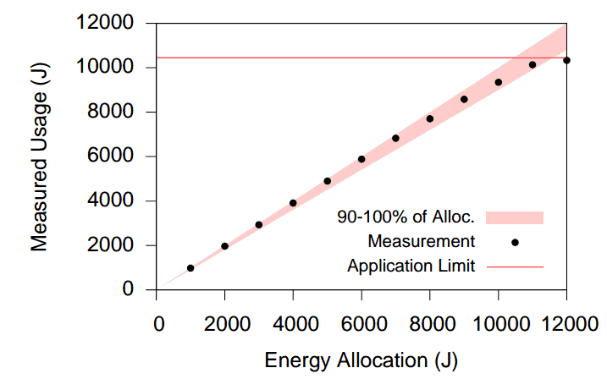
Result: energy stays within any budget
BUDGET
BUDGET

Slide 22
Questions?
Tech Report (more examples, implementation details) @
http://arcade.cs.columbia.edu/nrgx-tr14.pdf
Email: melanie@cs.columbia.edu
martha@cs.columbia.edu

